Slide 1
Metrics Dashboard
BrassRing
—
Client Training and Enablement Session
Talent Management Solutions
May 19, 2020

Slide 2
Agenda
How to use Metrics Dashboard?
Demo Examples of Visualizations
    Export Visualizations
    Sharing Visualizations
Tips & Tricks – Best Practice
FAQs
Resources
Other Important Information
Resources

Slide 3
How to use Metrics Dashboard
Overview
Allows users to create visualizations for different data points that are of interest to the user and the organization.
Goes beyond standard reporting to provide the user with a visual presentation of data within BrassRing and Lead Manager.
Allows users to create charts and graphs to easily analyze data.
Example: - How many total reqs are in a specific req status?
- How many candidates are in a specific HR status?
Available in Production ONLY.
Refreshed hourly
Rolling year of data is available in Metrics Dashboard.
Access to Metrics Dashboard is defined by user type privileges
Visualization the user sees is based on their Persona group.
Four standard visualizations are automatically to each user’s My Metrics Dashboard view:
    Total Reqs by Status
    Total Candidates by HR Status
    Total Submissions by Date Applied
    Total Leads by Lead Source (if using Lead Manager)

Slide 4
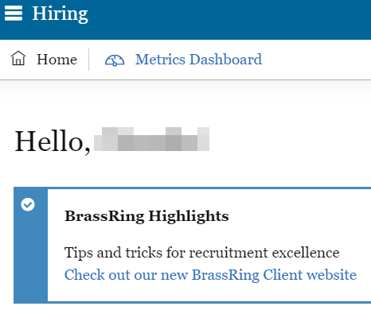
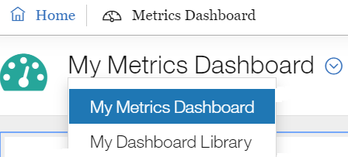
How to use Metrics Dashboard
BrassRing Home Page > Metrics Dashboard

Slide 5
How to use Metrics Dashboard
Two different Metrics Dashboard Views for users (non-Admins):
My Metrics Dashboard
Default view/workspace of visualizations created by user or subscribed to for the persona by the Admin.
User can edit visualizations based on user type privilege.
Four default visualizations will automatically appear for all users:
      Total Reqs by Req Status
      Total Candidates by HR Status
      Total Submission by Date Applied
      Total Leads by Lead Source (for clients with Lead Manager)
My Dashboard Library
Workspace of visualizations assigned by Admin based on user’s persona.
Read-only for ALL users.
Users can only see their current persona-specific view and its associated visualizations.
Users can subscribe/unsubscribe to visualizations from this view. Subscribing adds the visualization to their My Metrics Dashboard, while unsubscribing unlinks the visualization that the Admin maintains from the visualization on the My Metrics Dashboard workspace (making it a standalone visualization).

Slide 6

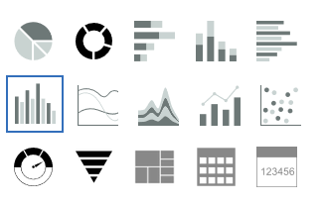
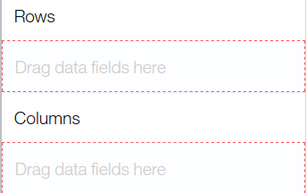
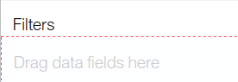


How to use Metrics Dashboard
Adding a new visualization to My Metrics Dashboard
Click the plus icon to add a new visualization
Select the chart or graph
(Note: You can always change this once you have your desired output)
Add your row and column labels by dragging and dropping. Your chart or graph refreshes to display the data.
You may also add filters (e.g. by date applied).
A filter icon appears with the number of filters that were added.
Gear icon allows you to change your row and column labels.
  Note: Your charts or graphs will refresh to reflect any changes you make.

Slide 7
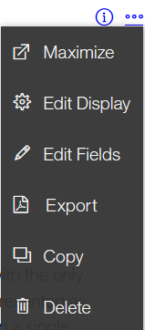
How to use Metrics Dashboard
Using the Actions Menu in Metrics Dashboard
Maximize – Expands your visualization to fit your entire screen.
Edit Display – Change the Title, Help Text, appearance of the visualization, and visualization colors.
Edit Fields – Edit chart or graph display, chart title, and help text.
Note: When updating chart type, rows and columns may be cleared if they do not meet the new chart’s criteria. Once cleared, you can’t retrieve the original visualizations. Recommendation: Make a copy of the original visualization prior to changing the chart type. (A warning message will pop-up if the chart type is incompatible with the chart type you are updating to).
Export – Export your visualization to PDF or Excel file depending on the chart.
The table chart is the only chart type that allows an export to Excel.
Copy – Creates a duplicate/copy of the visualization. If you are making a copy of a visualization you are subscribed to, the new copy of the visualization will NOT be linked to the subscribed visualization.
Delete – deletes the visualization from the workspace.
Note: If a visualization is deleted from Manage Dashboard, the visualization will be deleted from the current view only. Any user subscribed to the visualization will NOT have his/her version deleted.

Slide 8
How to use Metrics Dashboard
Subscribing to Visualizations from the Metrics Dashboard Library (Workspace of visualizations assigned by Admin based on user’s persona)
Subscribing to a visualization from the My Dashboard Library adds the visualization to the My Metrics Dashboard (creates a link between the user visualization and the My Dashboard Library counterpart).
Editing a visualization in the My Metrics Dashboard that was subscribed to from the My Dashboard Library will keep its source visualization link and update the timestamp.
The My Metrics Dashboard will display an alert in the header if any of the visualizations have a newer version available on the My Dashboard Library workspace. Selecting the alert icon will prompt additional actions to preview the new version, get the latest version, or overwrite or unsubscribe the version.
Unsubscribing the version creates a standalone visualization on the My Metrics Dashboard and removes the link to the My Dashboard Library version.

Slide 9



How to use Metrics Dashboard
Subscribing to Visualizations from the Metrics Dashboard Library
To subscribe to a visualization from the Metrics Dashboard Library:
  Navigate to My Dashboard Library by selecting the Select View dropdown menu.
  For a specific visualization, take the following actions:
The Add to my dashboard link allows users to add a specific visualization to My Metrics Dashboard. Once the visualization is added, the link changes to Remove from my dashboard and an additional link for Unsubscribe will display.
If the visualization was already added to the user’s My Metrics Dashboard, the Remove from my Dashboard link allows the user to remove the visualization from the user’s My Metrics Dashboard. The link then changes back to Add to my dashboard.
The Unsubscribe link will unsubscribe the user from the selected visualization. It unlinks the visualization the Admin maintains from the visualization on the My Metrics Dashboard workspace (making it a standalone visualization). Users will no longer see updates made to the visualization on their My Metrics Dashboard. To add the visualization on the My Metrics Dashboard again, use the Add to my dashboard link.

Slide 10
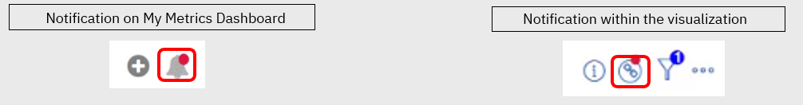
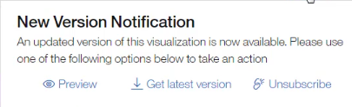
How to use Metrics Dashboard
Subscribing to Visualizations from the Metrics Dashboard Library
Once a user subscribed to a visualization, he/she can take various actions from the My Dashboard workspace such as edit fields, edit display, etc.
Admin users can make edits to visualizations the user has subscribed to. A notification will appear within that visualization to let the user know that a new version of the visualization is available.
  From the notification, the user can take the following actions:
Preview – preview the new version of the visualization.
Get latest version –overrides any edits you performed and replaces the visualization with the new version.
Unsubscribe – changes the visualization to a standalone version that will only appear on the user’s My Metric
Dashboard. The user will no longer receive notifications if edits are made to the version in the Dashboard library.

Slide 11
Demo
–
Metrics Dashboard – Examples of Visualizations

Slide 12
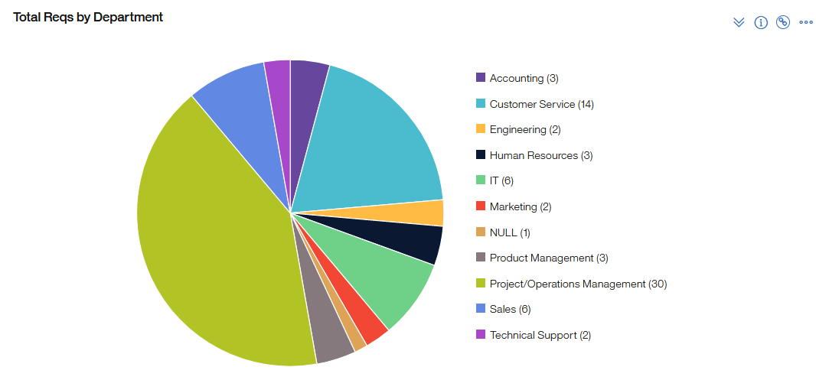
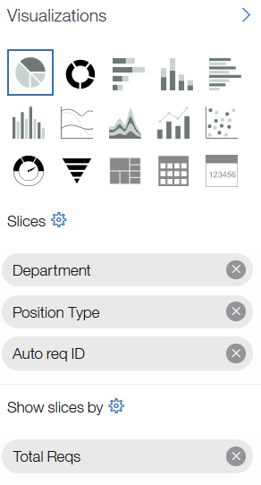
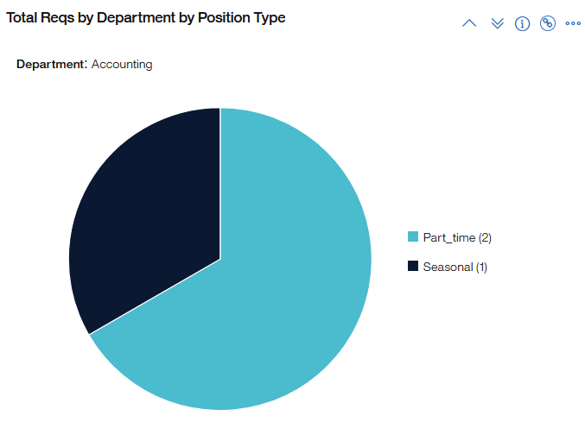
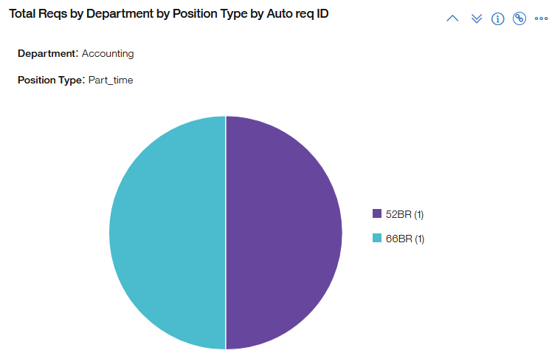
Example Visualizations
Different Examples Using Pie (Requisition Data using Pie Chart)
Slices: Department, Position Type, Auto Req ID
Show Slices by: Total Reqs

Slide 13
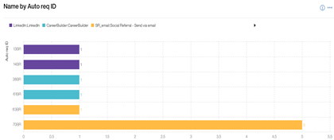
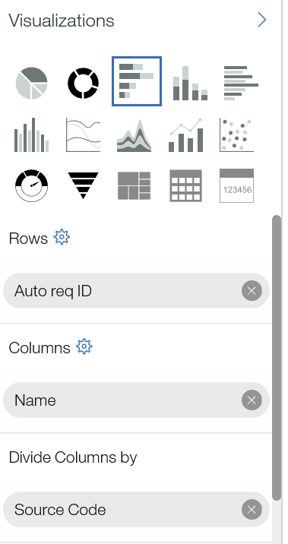
Example Visualizations
Source Code by Candidate
This Visualization provides the source codes of the candidates for each requisition.
Rows: Auto Req ID
Columns: Name(Candidate Name)
Divide Columns by: SourceCode

Slide 14
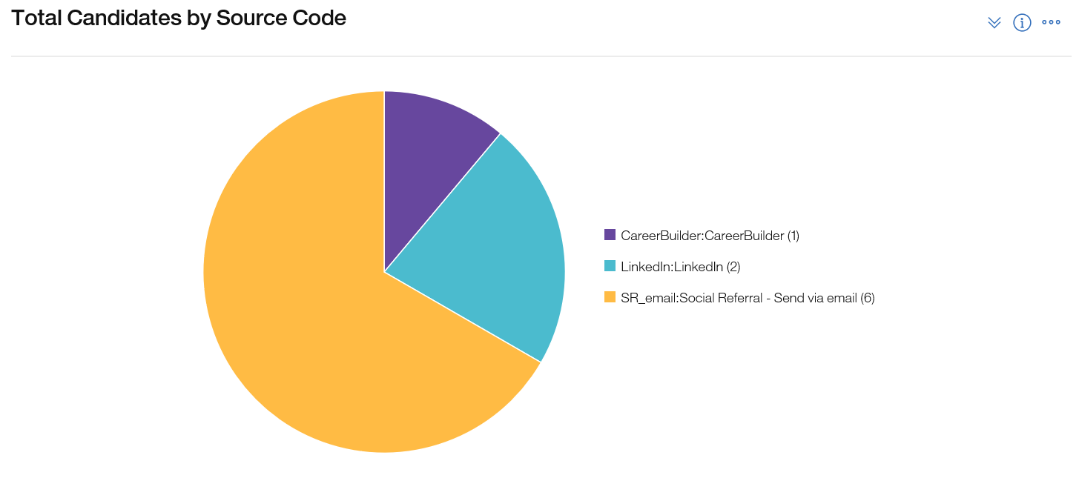
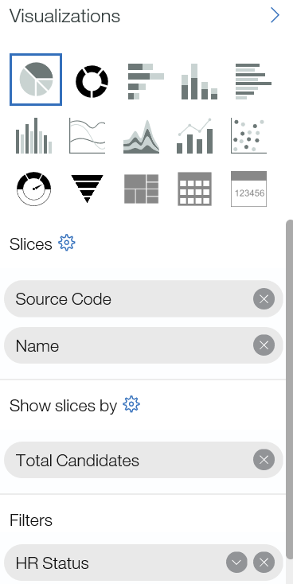
Example Visualizations
Complete Source Code Visualization
This visualization provides complete source report for the client.
Slices: Source Code, Name
Show Slices by: Total Candidates

Slide 15
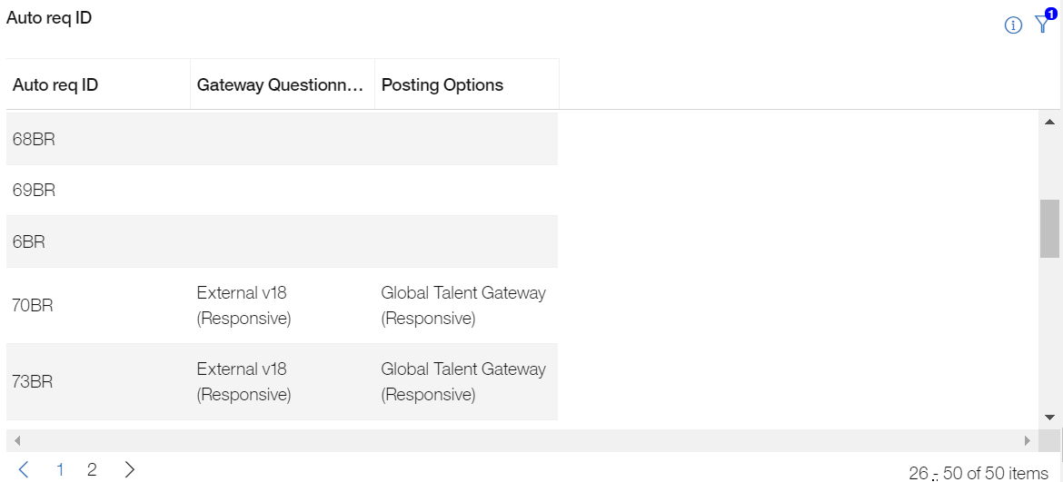
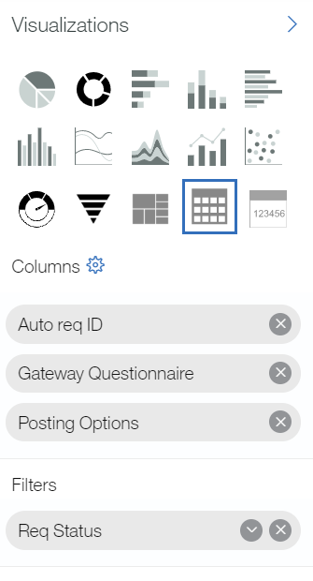
Example Visualizations
Reqs Assigned to GQs
Scenario
Client is converting from Classic TG to
Responsive TG and needs to know what reqs
have a GQ selected on the posting options page.
Solution
Build a Table Visualization with the following:
- Columns: Auto Req ID, GQ, Posting Option
- Optional Filter: Req Status = Open

Slide 16

Example Visualizations
Calculations can be used with Visualizations to Calculate the difference between two dates or find the average time between two HR Statuses.
Example: Time to Fill, Time to Review, Days Open by Positions Fill
Calculations are:
Built with numeric fields or date fields.
Built by using Groupings and a visualization can have multiple Groupings.
Added to the chart types of Pie, Donut, Stacked Bar Chart, Stacked Column Chart, Cluster Bar Chart, Clustered Column Chart, Pie, and Donut.
How to:
Add date/numeric fields to column sections | Create a group
Name the group | Add the fields
Add the calculation | Select the appropriate aggregation

Slide 17
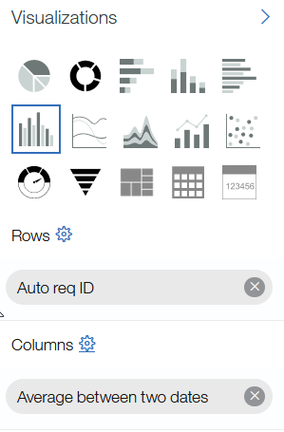
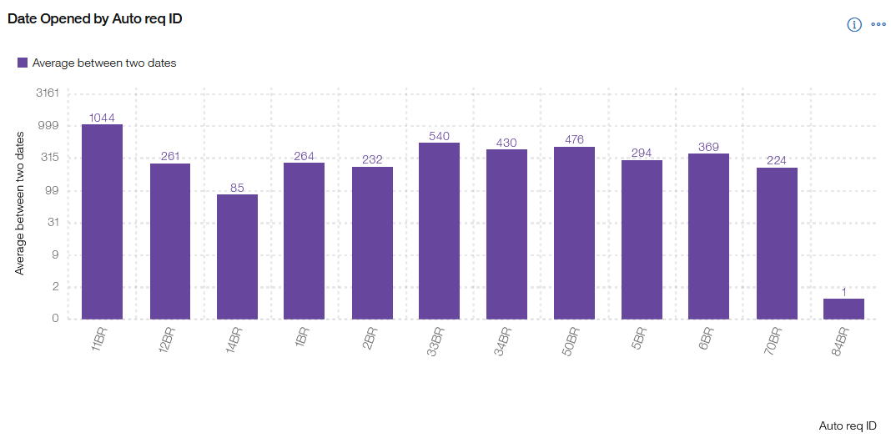
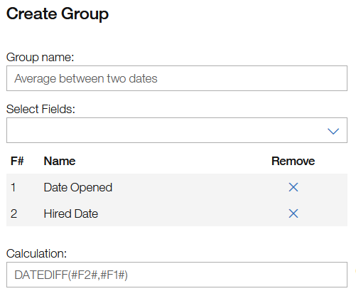
Example Visualizations
Average Function using Calculations
This Visualization provides the average between two dates.
Rows: Auto Req ID
Columns: Date Opened, Hire Date
Group Name: Average between two dates
Calculation: DateDIFF(#F2#,#F1#)

Slide 18
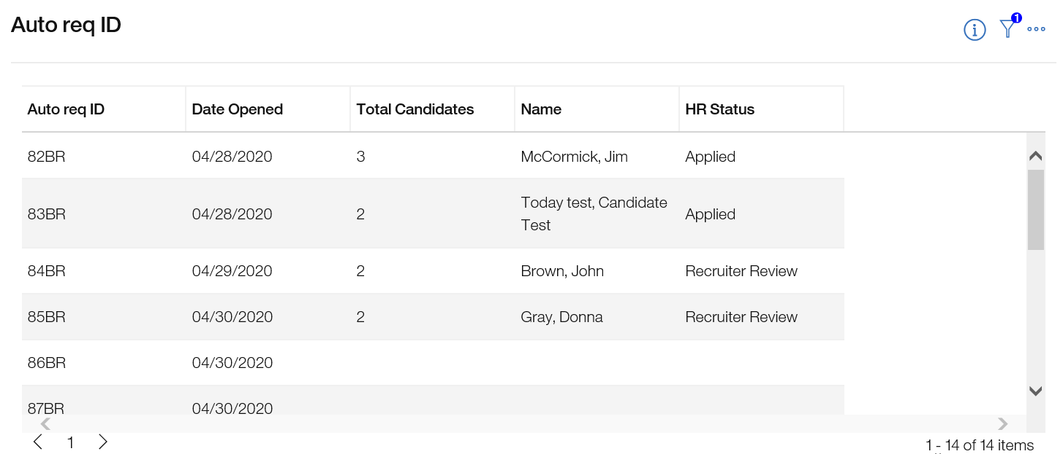
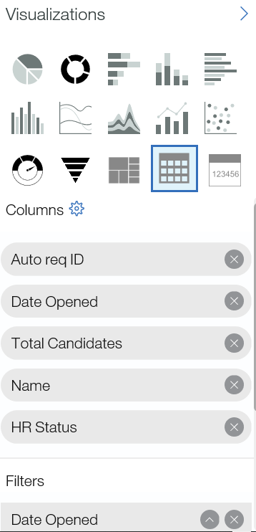
Example Visualizations
Requisitions Opened in the Past 30 Days
This visualization provides the number of requisitions that were opened in the past 30 days.
Columns: Auto Req ID, Date Opened, Total Candidates, Names, HR Status
Filters: Date Opened

Slide 19
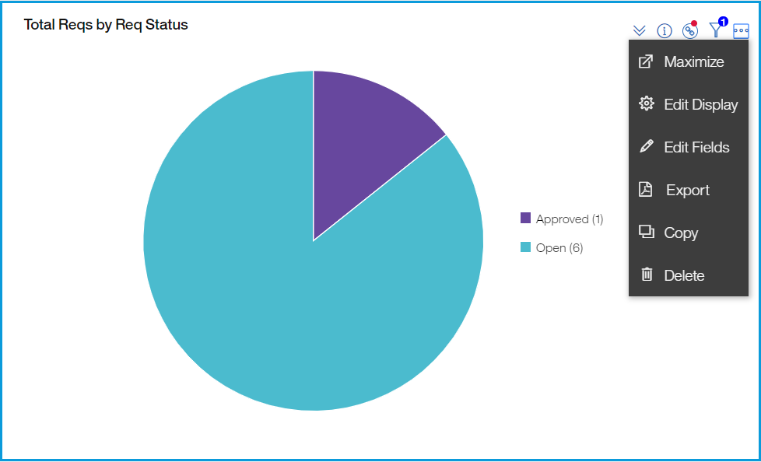
Export Visualizations
Visualizations can be exported to PDFs. Tables can be exported to a Microsoft Excel format.
BrassRing > Metrics Dashboard > Visualization > Actions > Export

Slide 20
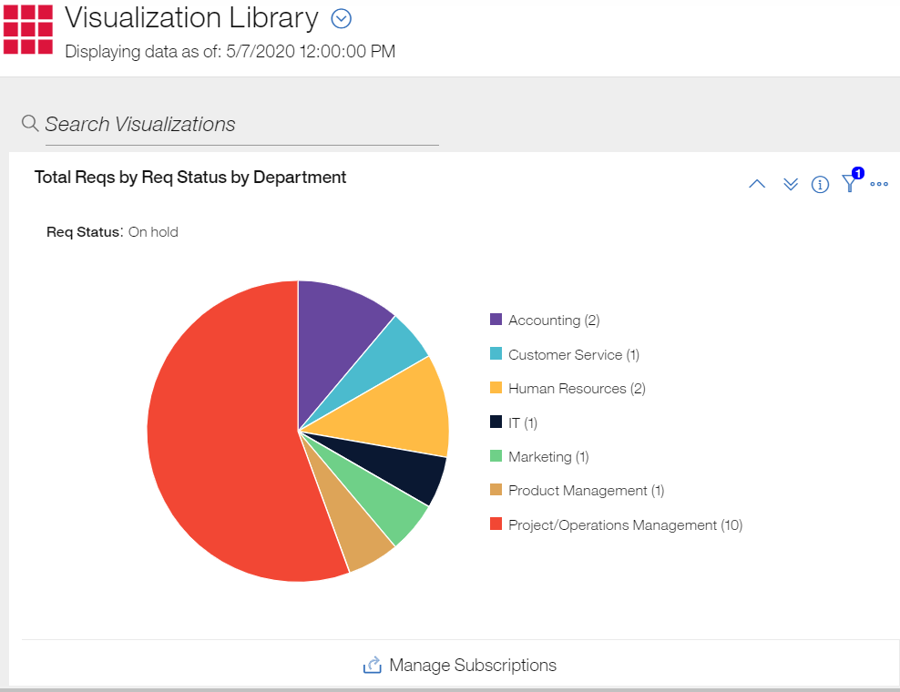
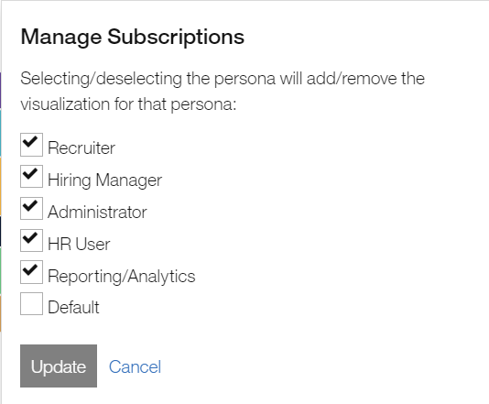
Export Visualizations
Users with Admin Access can share visualizations with persona groups.
Visualization Library – If you want to share the visualization with multiple personas. This way, you don’t have to create the visualization for each persona.
BrassRing > Metrics Dashboard > Visualization Library > For the specific visualization, select Manage Subscription > Select the appropriate persona groups.

Slide 21
Tips and Tricks – Best Practice
Tips and Tricks – Best Practice
Fields need to be enabled as searchable and outputable in order to include them in visualizations. Note that multi-select fields cannot be included as fields currently, but this option is coming soon.
When selecting a field for a visualization, drag it to the dotted frame of the section where it needs to be placed.
The log-in to Metrics Dashboard is not persistent from login to login which means if a user is on the Metrics Dashboard and logs-out of BrassRing, the next time user logs back in, they will be on the BrassRing Homepage and not the Metrics Dashboard.
When switching a visualization to a different visualization type, you may receive an error message that the previous visualization may have incompatible fields, this may mean that rows and columns will clear. Therefore, you may want to make a copy of the visualization first before you change the chart type.

Slide 22
Tips and Tricks – Best Practice
Tips and Tricks – Best Practice
Users can search visualizations in My Dashboard Library or Visualization Library by using the Search Visualization option.
If a user wants to add a new field to filter the visualization by, it must be added from the Field pane of the visualization.
Fields used in calculations need to be either numeric fields or date fields. You cannot mix numeric and date fields in calculations.

Slide 23
FAQs
FAQs
What date is the rolling year of data based off? It’s a rolling year from today’s date. Metrics Dashboard today, will have data back to May 18th, 2019.
Are user type permissions respected within Metrics Dashboard? Example: If I only have access to my reqs, are the visualizations going to reflect only the reqs I have access to, or will I see visualizations on every req? Yes, Metrics Dashboard looks at user type permission at req form/field level and candidate form/field level to show or not to show data. If the user only has access to MY reqs in BrassRing, they will only see data based on their reqs in Metrics Dashboard. If the user has access to see ALL reqs in BrassRing, they will be able to see data for all reqs in Metrics Dashboard.
When using ‘Date applied’ as the row for a visualization, what controls whether each day is shown in the rows or month by month? There is a standard visualization ‘Total Submission by Date Applied’ and this is broken down by each specific day. I mirrored that visualization using ‘Date Applied’ as the row with a similar date range; however, it is showing months on the row instead of days. Edit the date field using the gear icon in ‘Rows’ and change the date format to m/d/yyyy.

Slide 24
FAQs
FAQs
Do we have a way of displaying in Metrics Dashboard an average time a candidate is assigned to an HR Status? If so, can it be further filtered by Recruiter? Yes, you can use calculation for average time in HR status, and a filter of Recruiter or Hiring Manager.
Is it possible to built a visualization in Metrics Dashboard to display how many reqs are open during any given month? Yes, you could for example select a date range (1st of April to 30th of April). You can also select number of days back using ‘select days back’.
How can a visualization be shared with other users? Only users with Admin access can share visualizations with other users by personas.
What is the difference between Total Submissions and Total Candidates?
    Total Submission is the total number of jobs a candidate applied to.
    Total candidates provides the actual number of candidates. It doesn’t count a candidate multiple times if that candidate applied to multiple reqs.
Do we have an option to pull which Talent Gateways candidates use? Yes, Posting Options.

Slide 25
Resources
Overview of Metrics Dashboard
https://documentation.infinite.com/docs/the-metrics-dashboard
Working with Visualizations
https://documentation.infinite.com/docs/working-with-visualizations
Visualization Examples
https://documentation.infinite.com/docs/example-visualizations
Metrics Dashboard Calculations
https://documentation.infinite.com/docs/calculations
Administrator Functions
https://documentation.infinite.com/docs/administrator-functions

Slide 26
May VIRTUAL TRAINING SESSIONS
Client-facing training schedule
Check your skills!
Sunday | Monday | Tuesday | Wednesday | Thursday | Friday | Saturday
 |  |  |  |  | 1 | 2
3 | 4 | 5 | 6 | 7 Client: BR 20.05.04 and Onboard Release (11:00 AM EST) | 8 | 9
10 | 11 | 12 | 13 | 14 Client: Slack Ask Me Anything (11:00 AM EST and 4:00 PM EST) | 15 | 16
17 | 18 Client: Assess May Release (11:00 AM EST) | 19 Client: BrassRing Metrics Dashboard (11:00 AM EST) | 20 | 21 | 22 | 23
24 | 25 | 26 | 27 | 28 Client: Client Presentation – Edward Jones: Two-step Application Process (11: 00 AM EST) | 29 | 30

Slide 27
June VIRTUAL TRAINING SESSIONS
Client-facing training schedule
Sunday | Monday | Tuesday | Wednesday | Thursday | Friday | Saturday
 | 1 | 2 | 3 | 4 Client: BR 20.06.01 Release (11:00 AM EST) | 5 | 6
7 | 8 | 9 | 10 | 11 | 12 | 13
14 | 15 | 16 Client: TA Roadmap (11:00 AM EST) | 17 | 18 Client: Onboard Release (11:00 AM EST) | 19 | 20
21 | 22 | 23 Client: Offer Process/Forms – Responsive Candidate Zone (11:00 AM EST) | 24 | 25 | 26 | 27
28 | 29 | 30

Slide 28
Questions?

